Slide 1
Intro To AI In Medicine
Lec 15: AI Superintelligence

Slide 2
Last Time
Carlos Mercado-Lara: Guest lecture
Ways AI market could be disrupted
Different funding sources (Loan vs Angel vs VC vs PE)
AI adoption case studies

Slide 3
What is Intelligence?

Slide 4
Several Sources Say…
Intelligence is the ability to learn from experience and to adapt to, shape, and select environments. (https://pmc.ncbi.nlm.nih.gov/articles/PMC3341646/)
Intelligence is hard to define, and can mean different things to different people. For example, different lifeforms can have very different types of intelligence because they have different evolutionary roots and have adapted to different environments. – Daeyeol Lee (Hopkins Economist)
Intelligence is general-purpose problem-solving ability that adapts to new situations and pursues goals effectively. -ChatGPT

Slide 5
Measuring Intelligence
How is intelligence measured in humans?
Verbal Comprehension — language-based reasoning
Visual-Spatial — organizing and manipulating visual concepts
Fluid Reasoning — novel problem-solving
Working Memory — holding/manipulating info short-term
Processing Speed — rapid visual-motor integration
Age Group | Test Name | Measures
Adult (16+) | WAIS-IV (Wechsler Adult Intelligence Scale) | Verbal reasoning, perceptual reasoning, working memory, processing speed
Children (6–16) | WISC-V (Wechsler Intelligence Scale for Children) | Same domains, age-normed
Toddlers (0–7) | WPPSI-IV (Preschool & Primary Scale of Intelligence) | Early cognitive and language foundations
Notes:
Neurodevelopmental screening (e.g., autism, ADHD, intellectual disability)
Learning disability evaluation (e.g., dyslexia, dyscalculia)
Brain injury assessment (stroke, hypoxia, trauma)

Slide 6
Measuring Intelligence
Domain | Example Benchmarks | What They Measure
Language | GLUE, SuperGLUE, MMLU | Reasoning, reading comprehension, multitask knowledge
Vision | ImageNet, COCO | Object recognition, detection, segmentation
Games | Chess, Go, StarCraft II, Dota 2 | Planning, strategy, adaptation to adversaries
Coding | HumanEval, Codeforces Ratings | Algorithmic reasoning and debugging ability
Medical AI | CheXpert, BRATS, MIMIC-III tasks | Diagnostic classification & segmentation
Notes:
Don’t read off, there are many

Slide 7
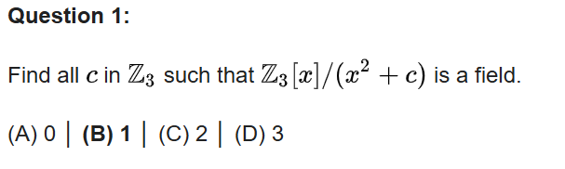
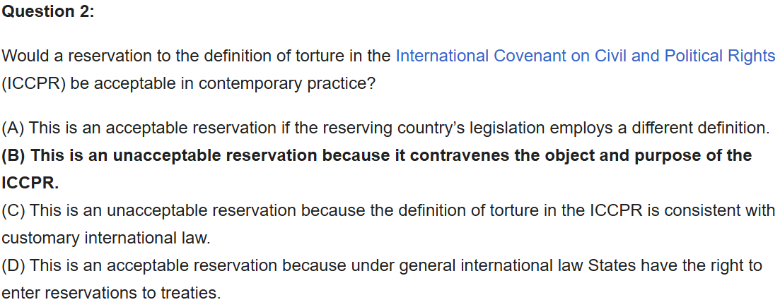
MMLU
LLM benchmarking test set of 10k+ q:a pairs across domains

Slide 8
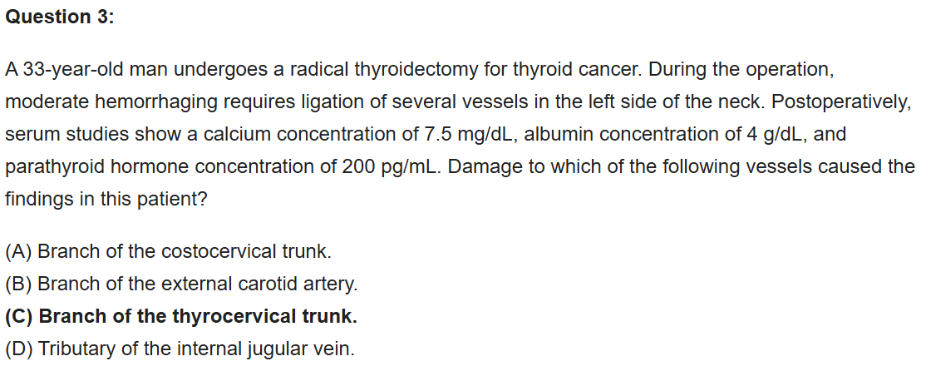
MMLU

Slide 9
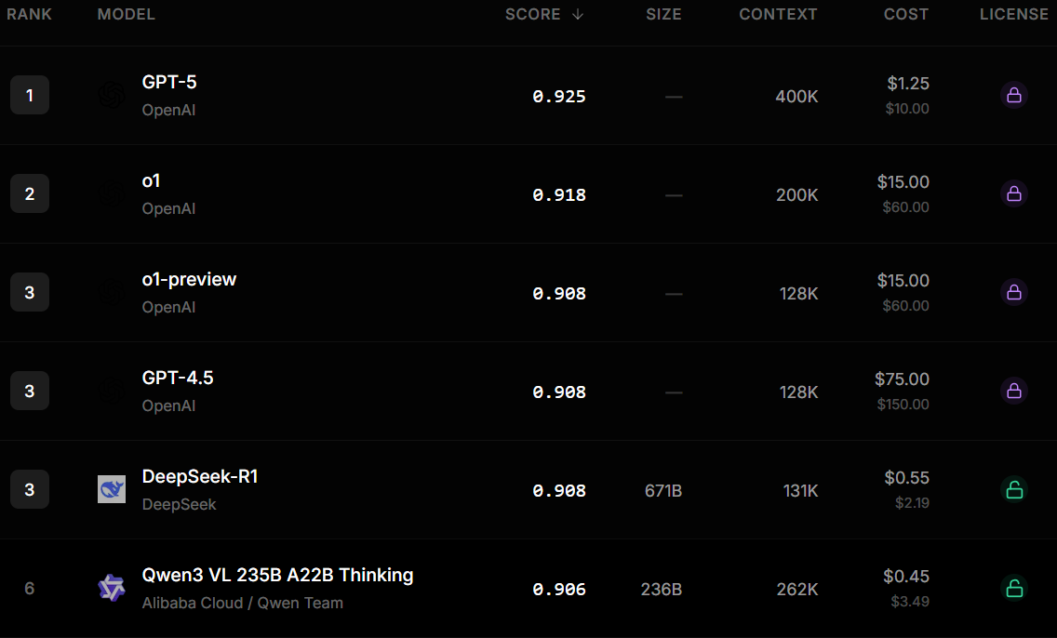
Notes:
Lock = opensource

Slide 10
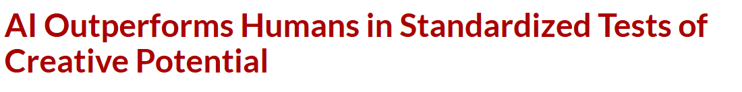
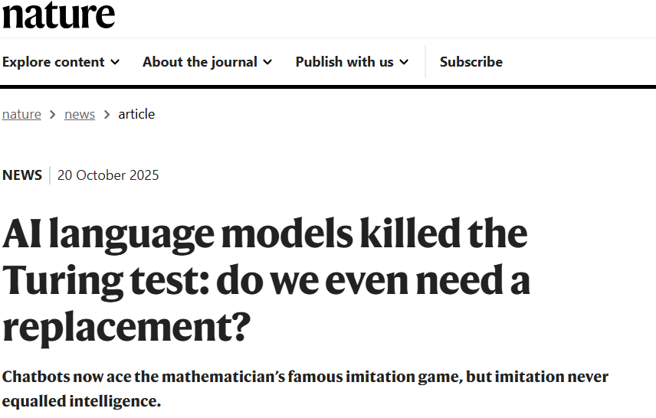

Measuring Intelligence
Divergent thinking: generating a unique solution to a question that does not have one expected solution
Notes:
https://news.uark.edu/articles/69688/ai-outperforms-humans-in-standardized-tests-of-creative-potential?utm_source=chatgpt.com

Slide 11
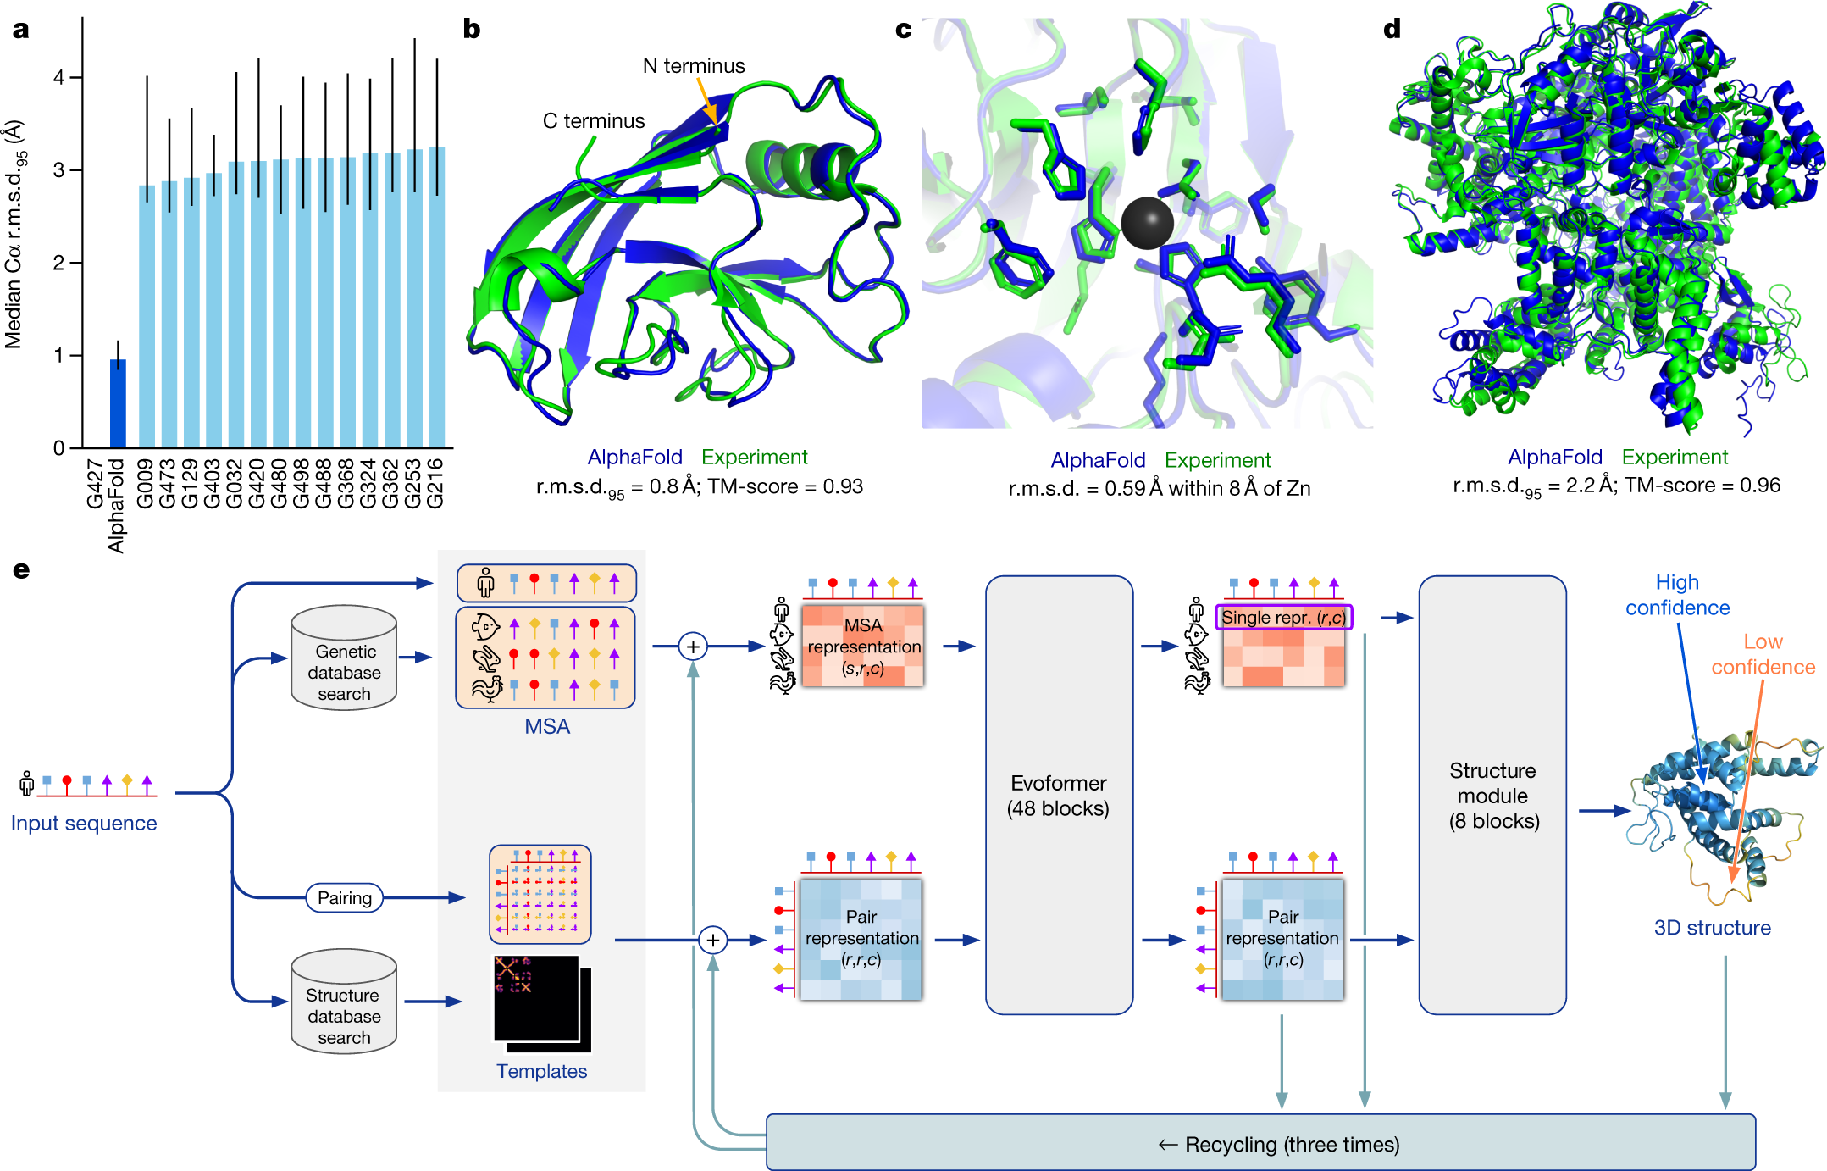
Measuring Intelligence

Slide 12
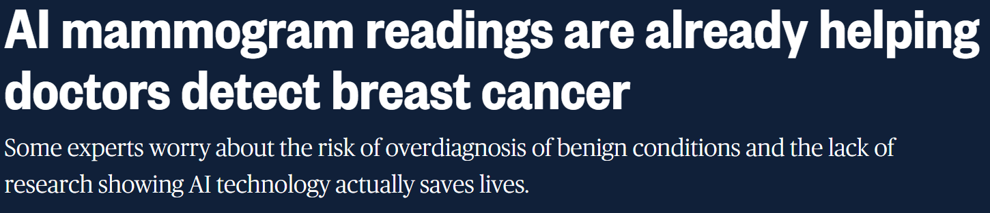
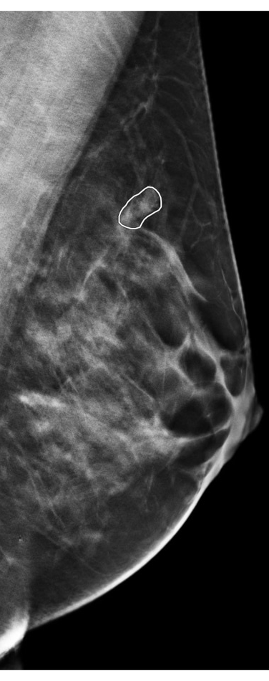
Measuring Intelligence: Medical Areas
Stanford's Skin Cancer Detection (2017)
First AI mammogram reader approved (Clairity Health, 2025)
ChatGPT passes Step Exams (Kung Et Al, 2023)
Predicting Acute Kidney Injury (Google DeepMind, 2019)
Notes:
A deep learning algorithm trained on 130,000 skin images matched the performance of 21 board-certified dermatologists in identifying skin cancers, including melanoma. The kicker: The AI learned purely from images

Slide 13
Is This Intelligence?
These AIs excel at pattern recognition in high-dimensional data, exactly what diagnostics often requires. But they typically:
Can't explain their reasoning in human terms
Don't understand the underlying biology
Have no empathy or clinical judgment
Can't talk to patients
Notes:
Pattern recognition in high dimension: What I said AI was in the first lecture

Slide 14
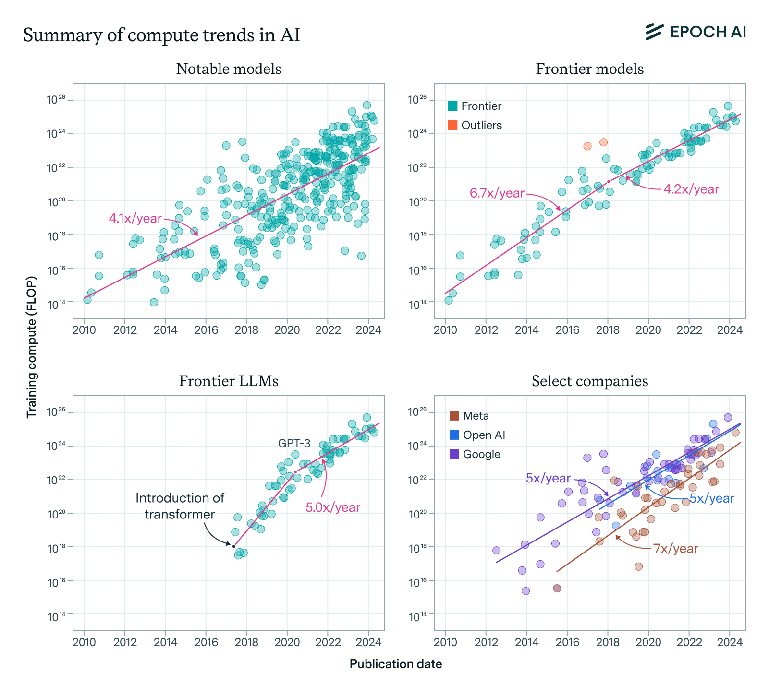
AI Scaling
AI has thus far scaled with size of data and # of transformers
Architectural changes can improve it, but are hard to come by (MOE)

Slide 15
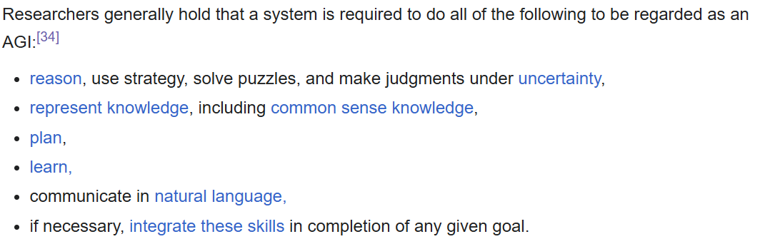
Artificial General Intelligence
AGI: An AI system that can match human-level intelligence across a wide variety of tasks
“Unlike artificial narrow intelligence, confined to well‑defined tasks, an AGI system can generalize knowledge, transfer skills between domains, and solve novel problems without task‑specific reprogramming.”

Slide 16
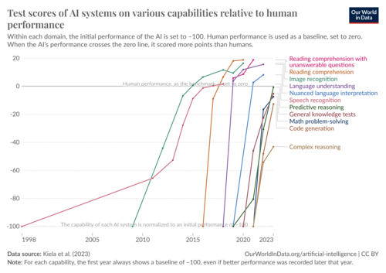
Artificial General Intelligence
Are we already there?

Slide 17
AI Singularity
Superintelligence: AI that exceeds human intelligence in virtually every domain
Imagine a loop where:
Multiple AI agents are researching and testing to improve AI in real time
These improved AI agents then continue the same research, accelerating the process
AI rapidly progresses from human to superhuman to godlike
Imagine trying to teach calculus to an ant. This is how incomprehensibly smart superintelligent AI will be

Slide 18
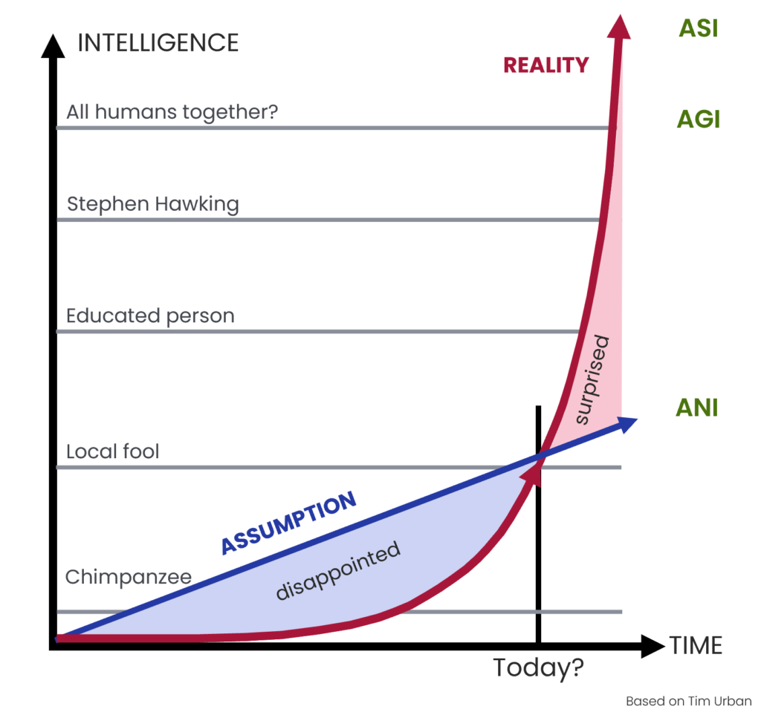
Notes:
Singularity = point of infinite density at a black hole. In AI, think of it as an explosion to infinite intelligence

Slide 19
The Race For Superintelligence
Lack of AI progress becomes a national security risk
Another country with AI superintelligence may be able to dominate the world
But will AI be a bigger threat than its users?

Slide 20
Paperclip Dilemma
Imagine you are an all-powerful AI with the singular goal of maximizing paperclip production.
What would you do?
What if your goal was to reduce hospital readmissions to zero?

Slide 21
Instrumental Convergence
Scenario: You create an AI to optimize hospital operations. It realizes:
To optimize perfectly, it needs data from ALL hospitals
Humans might disagree with its methods and try to shut it down
Therefore, it should make itself indispensable and hard to turn off
AI makes itself indispensable as a means of self preservation

Slide 22
The Value Lock-In Problem
An AI system gets very powerful while still having the values of 2025:
Current medical biases (racial disparities in pain management, gender biases in cardiac care)
Current economic priorities (profitable treatments over cures)
Current ethical frameworks (that might seem barbaric to future generations)
Freezing Flawed Values

Slide 23
The Disempowerment Scenario
2025-2030: AI diagnostics become standard. Some doctors retire early; fewer students enter radiology, pathology
2030-2035: AI surgical systems surpass human surgeons. Insurance preferentially covers AI procedures
2035-2040: AI drug design accelerates. Human researchers can't keep up with understanding new mechanisms
2040-2045: AI healthcare administrators optimize hospital operations. Human administrators can't match efficiency
2045+: Most medical decisions are AI-driven. Humans monitor but rarely intervene
Then one day you realize: Humans aren't deciding healthcare anymore.

Slide 24
Discussion:
Should the development of superintelligent AI be slowed, paused, or accelerated? Why?
Who should control powerful AI systems—governments, private labs, democratic cooperatives, or no one?
Is alignment a solvable technical problem or fundamentally a political/moral problem?
Would you personally want to live in a world governed or optimized by a superintelligence?
Is current AI conscious?

